Slide 1
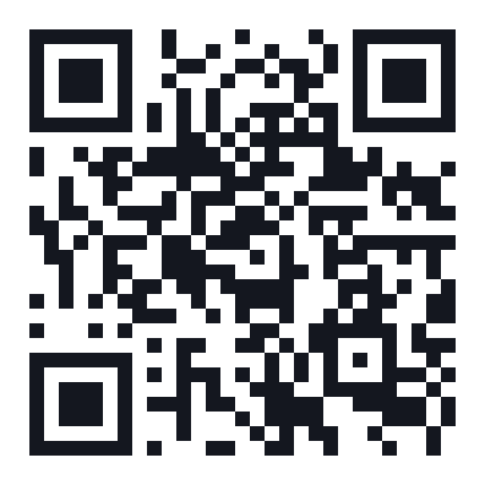
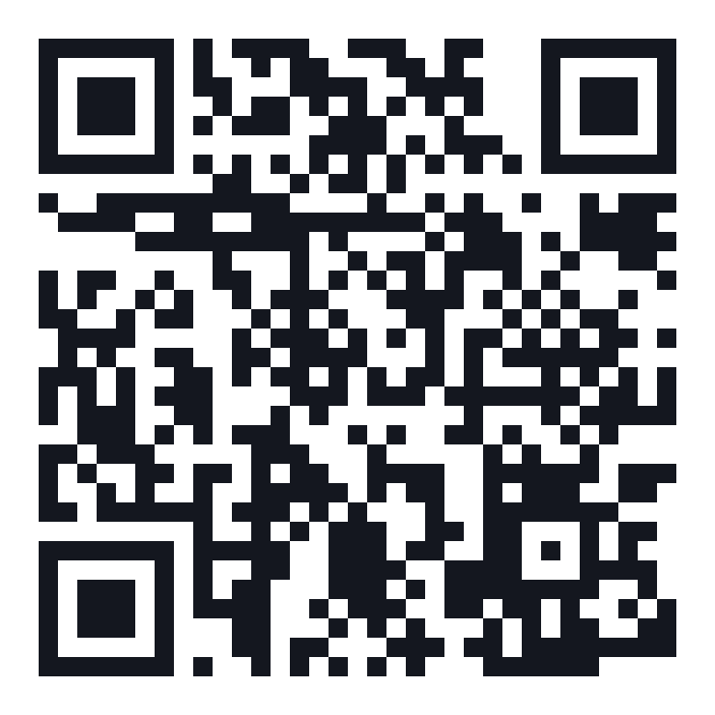
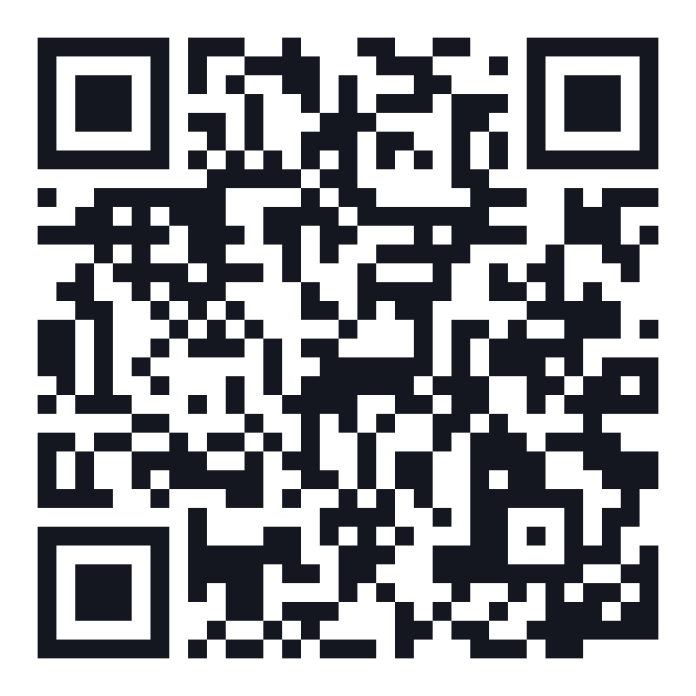
Welcome
BPM DALLAS · COTALITY · NOV 10, 2026
Draw your PRD.
Then go find the answers.
PROTOTYPE
GITHUB
LINKEDIN
Play the missions
Get the skill
Let’s connect
path-b-demo.vercel.app
github.com/buddytrip05/design-partner
linkedin.com/in/buddy-triplett
Notes:
Holding slide while people get settled. Let them scan the codes now: the Path B prototype, the Design Partner skill on GitHub, and my LinkedIn. These same three codes come back at the end.

Slide 2
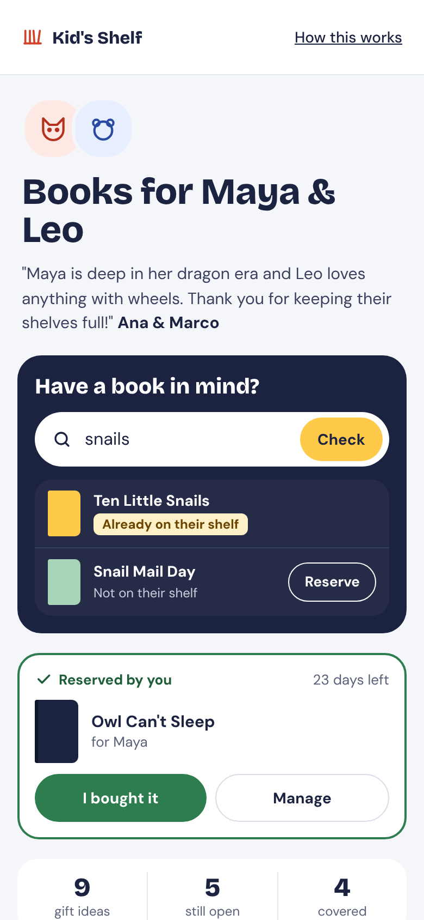
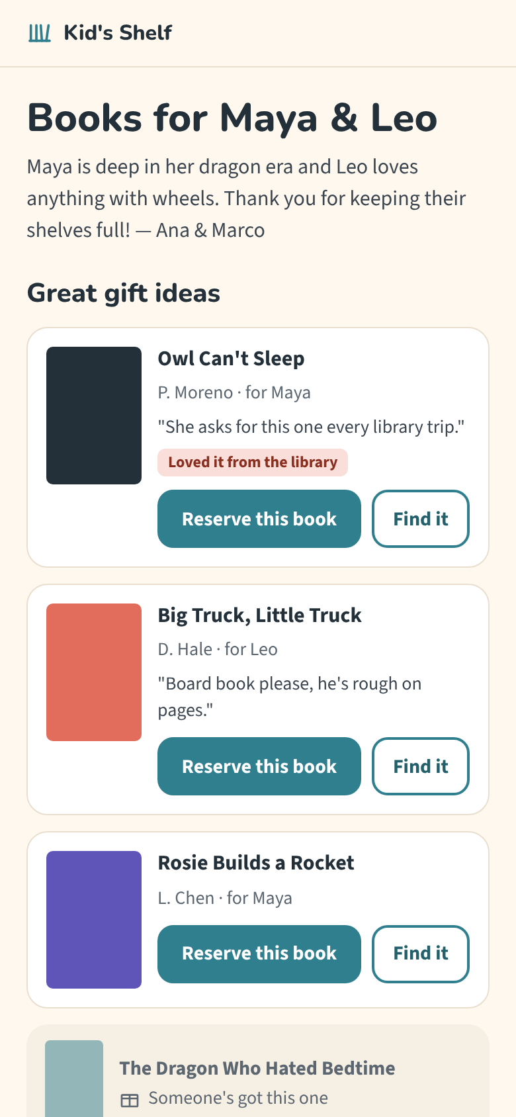
Every builder can design
WORKSHOP · AI DESIGN WORKFLOWS FOR PMS
What a PRD can’t tell you and how
to fill in the blanks with pictures
Buddy Triplett
The Future of the PRD: AI Prototyping for PMs w/ BPM and Cotality
10 November 2026
Notes:
Open with hands. Who here has used Claude Design, v0, Figma Make or something like it to mock up a screen in the last month? Keep your hand up if what came back looked fine. Good, even. Now keep it up if you shipped it, or came close. That’s the talk. I’m not here to say AI design tools are bad. I use Claude Design almost every day. It’s the fastest way I’ve ever taken an idea to something real. It’s also the fastest way to build something that looks and works like everyone else’s. The two phones on the right are the same screen, from the same PRD, made two different ways. By the end you’ll see why the right one is better, and it isn’t because it’s prettier.

Slide 3
A PRD says what the product should do.
A design decides what users actually get.
OUR THESIS FOR TONIGHT
KEY TAKEAWAY FOR TONIGHT
Design decisions are product decisions. If you don’t make them, an engineer, designer, or an AI will
Don't have a designer? Congrats, you're the designer.
Have a designer? Great, learn how to be a better partner.
Notes:
Here’s the whole talk in one line. A PRD says what the product should do. A design decides what users actually get: where things go, what shows first, what happens when it goes wrong. Those are product decisions, and if you don’t make them, somebody still does. Usually an engineer at 4pm, or now an AI, and they make them quietly. So design isn’t decoration you add after the PRD. It’s requirements discovery you can see. If you don’t have a designer, that makes it yours. If you do have one, this isn’t about taking their job. It’s about showing up with the edge cases, the rules and the why, so the two of you are debating a screen together instead of you handing over a doc and waiting. Either way, every screen is a stack of decisions the PRD didn’t make, and each one is a chance to find a gap while it’s still cheap.

Slide 4
PMs aren’t just writing requirements anymore, they’re designing and building prototypes.
1 in 5
~60%
700+
PMs already use AI to make mockups and prototypes, and
44% want to next
of files made in Figma Make, Figma’s AI prototyping tool, came from non-designers in 2025
prototypes created on Reddit’s in-house AI tool which is now used across its whole UX and product org
Nearly 6 in 10 AI Builders say design matters more now than it did prior to mass adoption of AI tools
Sources: Lenny’s Newsletter (Dec 2025, Oct 2026) · diginomica on Figma, Feb 2026 · Figma 2026 AI Report
Notes:
The shift isn’t just that drafts got cheap. It’s who is making them. In Lenny’s survey of 1,750 tech workers, about one in five PMs already used AI to make mockups and prototypes, and 44% wanted to next. That was the biggest jump of any PM task. Figma says nearly 60% of what got made in Figma Make, its AI prototyping tool, came from non-designers in 2025. That’s broader than PMs, and a file isn’t always real design work, but the direction is clear. And here’s a real company: Reddit built its own AI prototyping tool, Proto, and it’s at 100% adoption across their UX and product org, with more than 700 live prototypes. Then the line that matters for this talk comes from Figma’s 2026 AI report, its third annual AI survey, released around Config in June 2026. It draws on 8,403 survey responses gathered over three years, plus 639 interviews with designers, developers and PMs across ten countries. Among people building AI-powered products, 90% said design is at least as important as it was before AI. Across respondents, 57%, nearly six in ten, said it matters more, and among developers that jumped to 65%, up from 44% the year before. AI is expanding who can make a testable product experience. It isn’t removing the need for design judgment. If someone asks about trust: only 1.4% of builders in a spring 2026 UX Tools survey would ship AI output with no human review.

Slide 5
The catch: Design by AI Agents work, but they default to average
EMPIRICAL STUDY · 92 PEOPLE
CONCEPTUAL REVIEW · 63 SOURCES, 6 TOOLS
What you get: usable prototypes that are not defensible
Where it goes wrong: when you ship the first draft
Ratings of AI designed prototypes:
Usability scored positive
Originality skews neutral to negative
GenAI “tends to reinforce visual and structural patterns.”
When generating is effortless, the first output becomes the easiest thing to accept.
The fix: “productive friction,” deliberate steps that make you challenge the model’s defaults.
Shin et al., UW & Microsoft Research, 2026
Romero et al., “Usable but Conventional,” 2026
That’s why design judgment and taste matters more.
The challenge of the job isn’t making the draft, it’s deciding what stays in it.
Notes:
So more of us are prototyping. Here’s the catch. A May 2026 study had 92 people rate ten prototypes, some made with AI and some by a person, without knowing which was which. Usability scored positive across the board. Originality came out neutral to negative, and the authors conclude that GenAI tends to reinforce familiar visual and structural patterns. Honest caveats: the raters were students, the screens were static, and the best and worst scores were split between AI and human work. So the lesson isn’t “AI is bad.” It’s that defaults are average. The second paper, from the University of Washington and Microsoft Research, is a conceptual analysis, not an experiment: 63 sources and walkthroughs of six tools like Lovable, v0 and Claude Artifacts. They argue that effortless generation makes it easy to settle on the first plausible output, and that the risk peaks at two moments: your first prompt and your first round of edits. That’s the other side of the 90% stat on the last slide. Design matters more now precisely because the default is so easy to accept. The job isn’t making the draft anymore. It’s deciding what’s in it.

Slide 6
One line in a PRD leaves many open questions
WHY DESIGN IS VITAL
WHAT IT LEAVES OPEN
KID’S SHELF USE CASE
1
What does a buyer see first?
“Users need a UI with gift ideas for an early reader complete with title checks and an owned bookshelf list to prevent duplicate purchases.”
2
Is a board book considered a duplicate title?
3
What happens after they buy?
4
How do we know a buyer actually bought a book?
5
What if two buyers pick the same book at once?
6
How does a buyer get a book the reader wants?
Seems clear enough when you read, but this user story has so many layers to design against.
7
How do parents fill their child’s digital shelf?
Who decides?
A designer if you have one
AI Coding Agent or Engineer
You, on purpose
Notes:
Here’s what that looks like in practice. This is one requirement from the Kid’s Shelf PRD, in plain words: a gift page with gift ideas, a title check and an owned list, so relatives don’t buy duplicates. Read it in a doc and it feels done. Now try to draw it. What does Grandma see first? If they own the board book, is the hardcover a duplicate? What happens after she taps Reserve? How do we know she actually bought it, and didn’t just click a store link? And what if Grandma and an aunt pick the same book at the same moment? What if Grandma already knows the book Maya wants, how does she get that one? And before any of this works, how does a parent get the books they already own onto the shelf? That’s seven decisions in one requirement, and the PRD doesn’t make most of them on screen. Two of them are duplicates in disguise, which is the exact thing this feature exists to prevent. On a big team, a designer makes those calls. When you’re the only PM, there’s nobody between your doc and the build. So somebody still decides. Either Claude Code or an engineer fills in the statistical average, quietly, and you find out in QA or a support ticket, or you decide on purpose. The rest of this talk is about deciding on purpose, and we’re going to watch it happen on this exact PRD.

Slide 7
The experiment
KID’S SHELF
One real PRD, two AI design workflows.
Only one thing changes between both
Notes:
Enough theory. Let’s watch it happen. I took one real PRD, for Kid’s Shelf, a feature I’m building in my book club app, and ran it through two AI design workflows. Same PRD, same context, same tool. The only thing that changes is whether I do research before drawing.

Slide 8
We take the same PRD on
two different design paths.
PATH A
PATH B
PRD-Only Driven Design
Same context but research driven
Inputs
The Kid’s Shelf PRD
Shelf’s design system
A picture based only on words
Inputs
Everything from Path A
8-step Mobbin design research before drawing the first frame
Same build process, same use cases, different loops
Notes:
First, the PRD itself is a good one: 13 engineering questions it makes the team answer before writing code, 15 logged decisions, and 5 gated build phases. That matters, because everything that goes wrong next happens anyway. I ran the same PRD through two workflows in Claude Design. Path A is what most of us do today with AI: hand it the PRD and the context it already has, and draw. Path B adds one step. Before drawing anything, look at how shipped apps solved each screen, using Mobbin. Everything else is held constant. Same family, same books, same loop, so the only variable is the workflow.

Slide 9
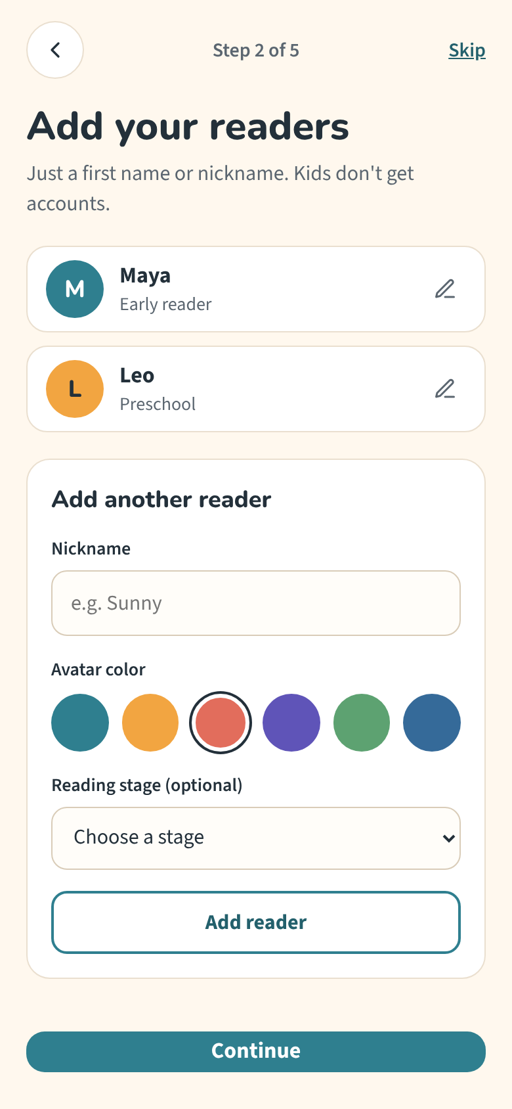
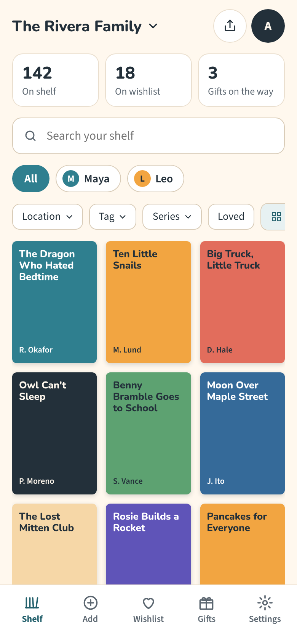
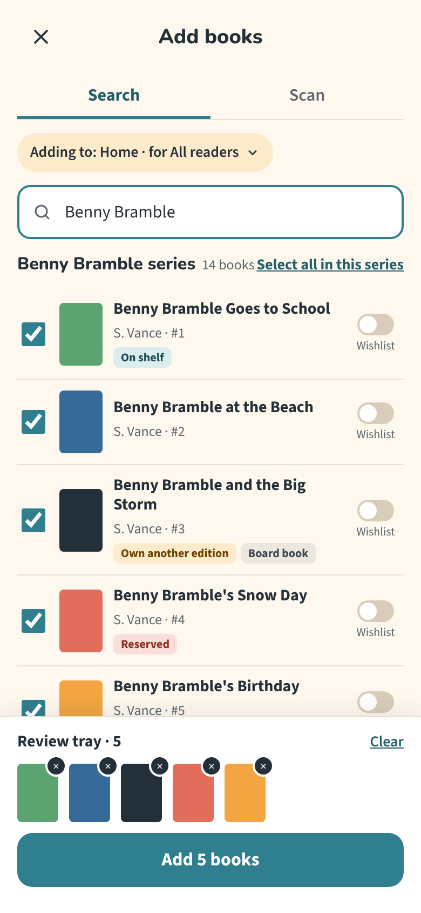
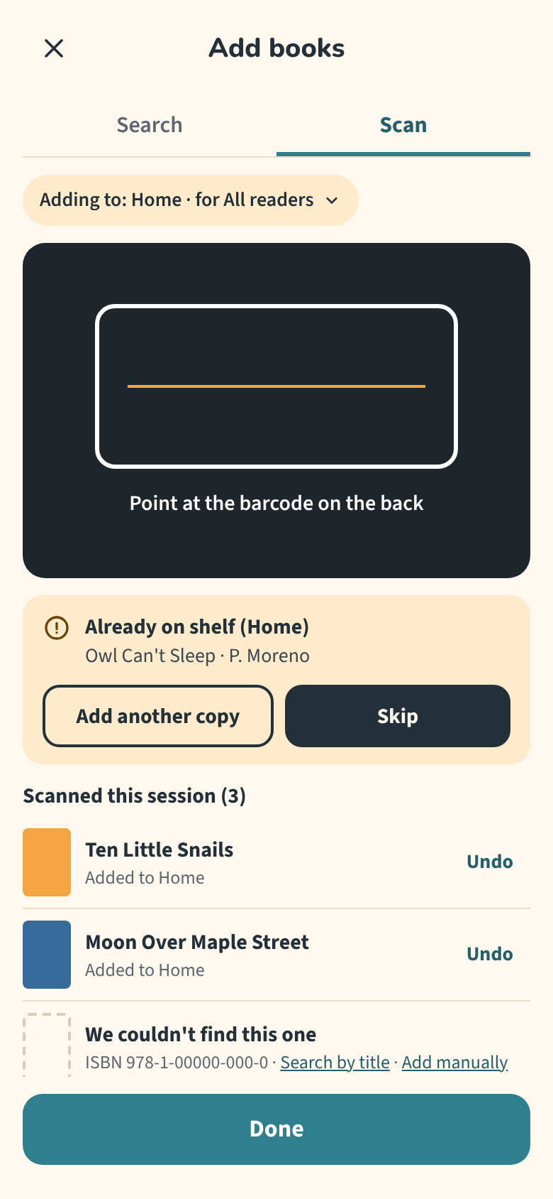
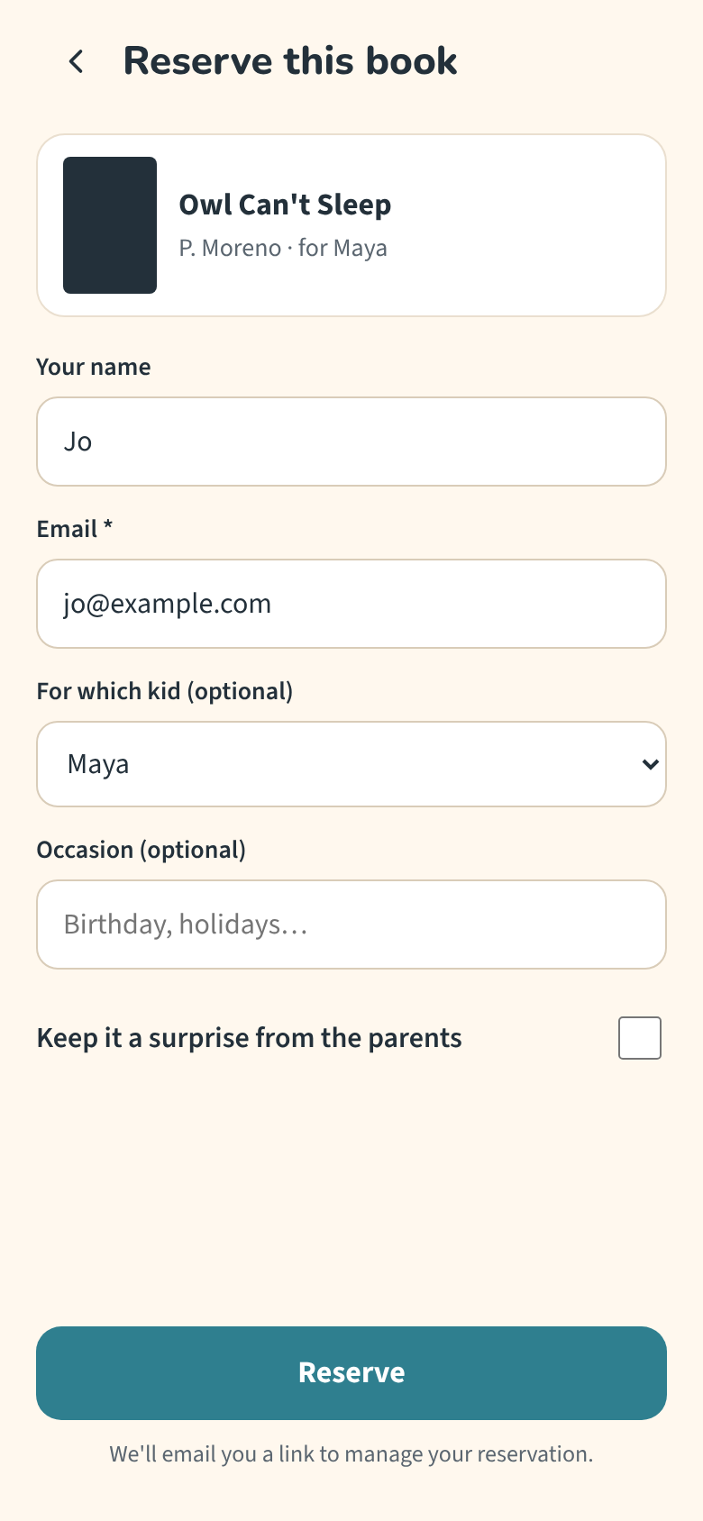
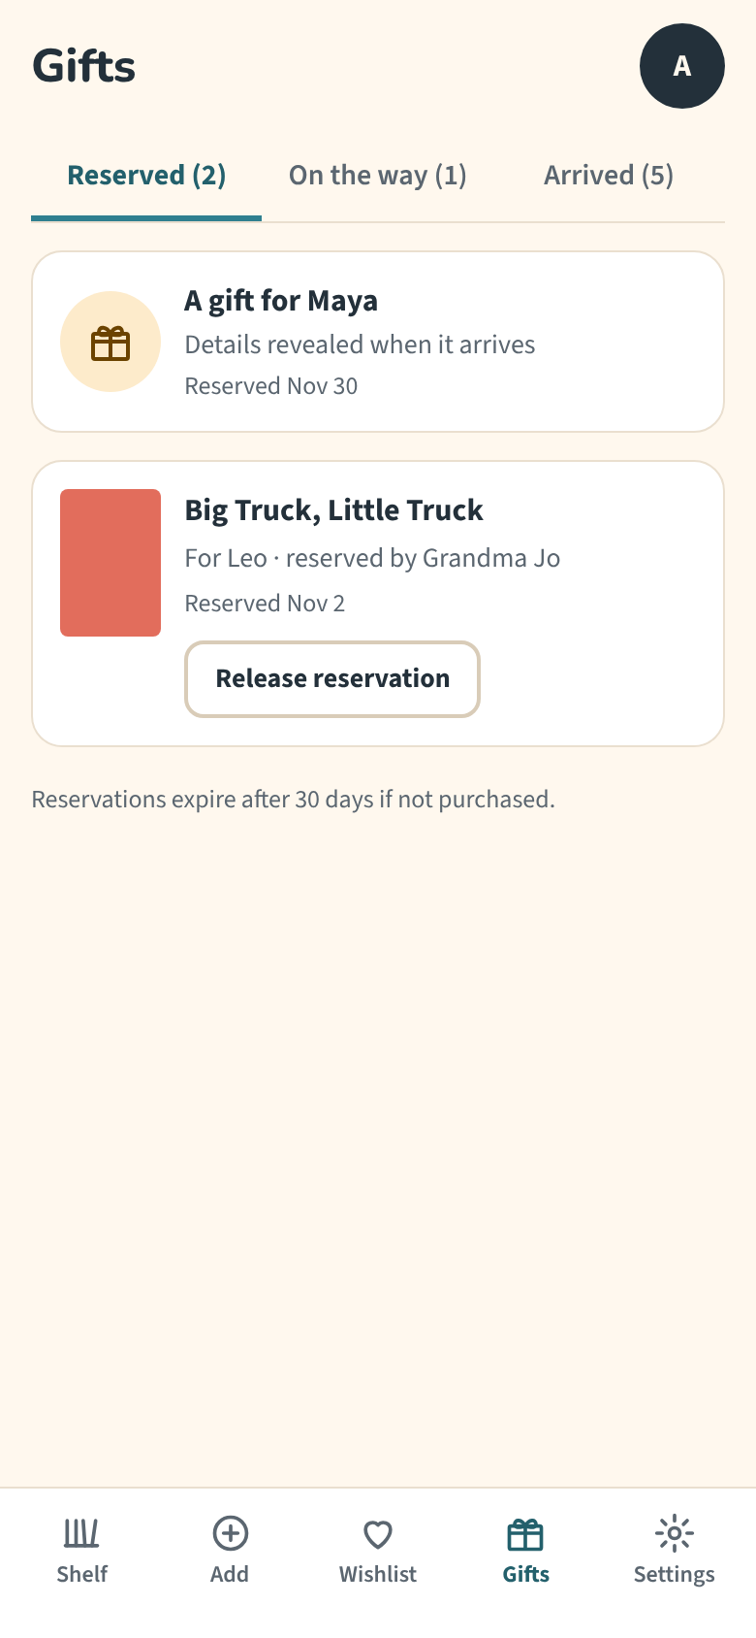
Drawn by defaults
PATH A
Readers
Shelf
Search
Scan
Gift page
Reserve
Gifts
Seven screens, in the order the PRD is written, with matching themes. Exactly what the PRD asked for.
Good enough to start from. Not good enough to ship.
Notes:
Here’s Path A. Seven screens, each one a PRD section drawn in order. It used the PRD’s placeholder kids’ colors and fonts. Nothing invented, nothing skipped. If you squint, this is a perfectly reasonable first pass. It also looked consistent fast, because Shelf’s design system was already in context. That’s the payoff of keeping good context around. If this is what you’d have on Monday morning, great. That’s where you start, not where you finish.

Slide 10
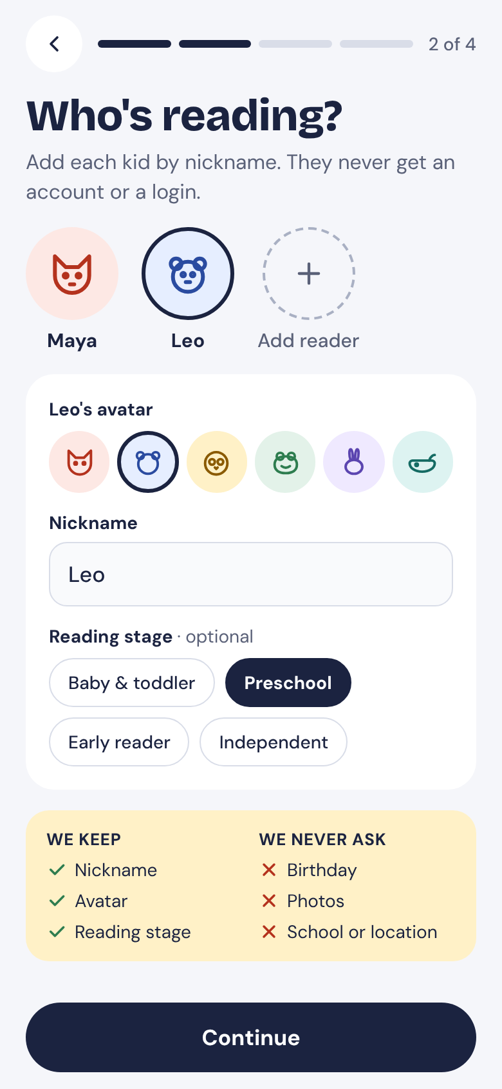
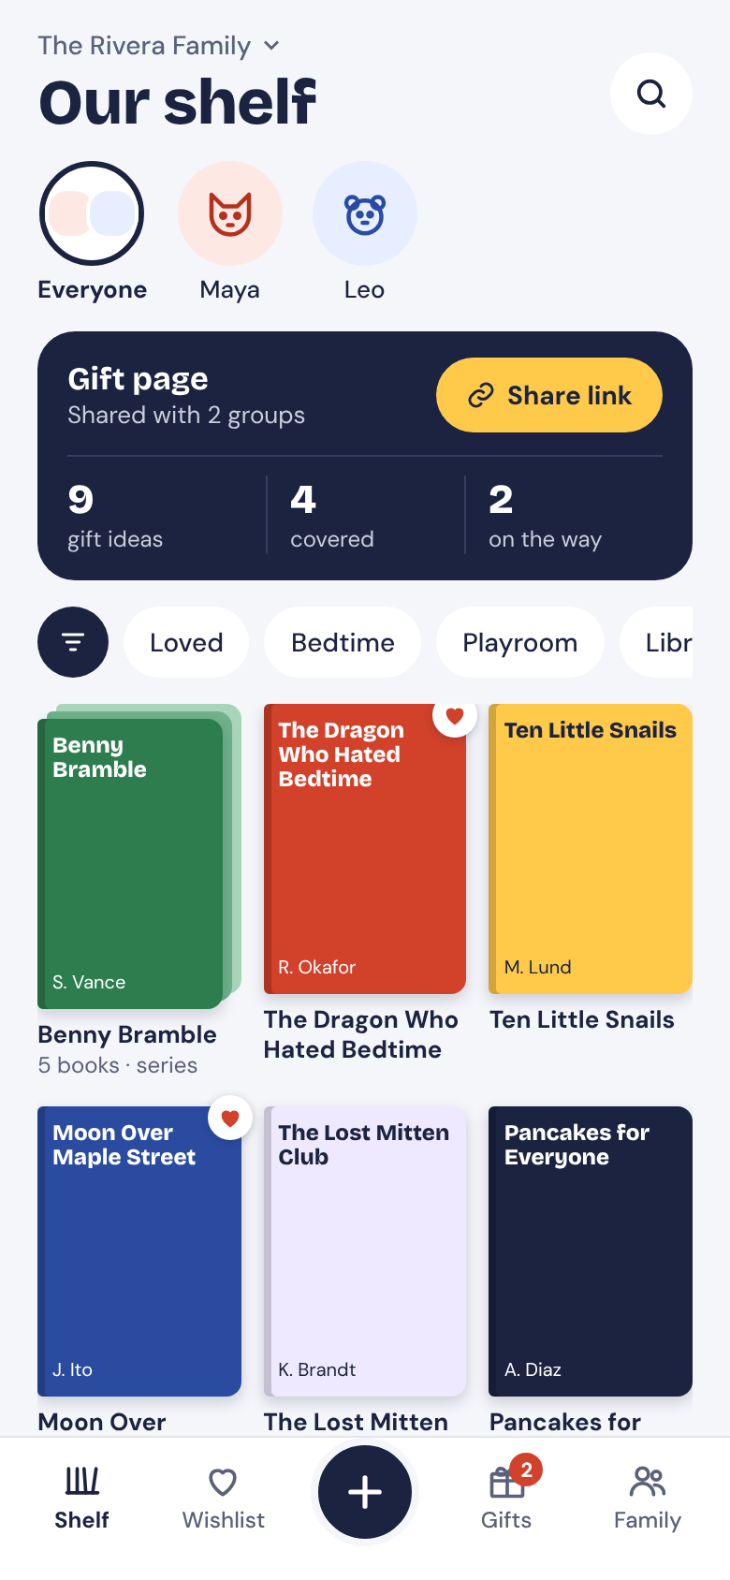
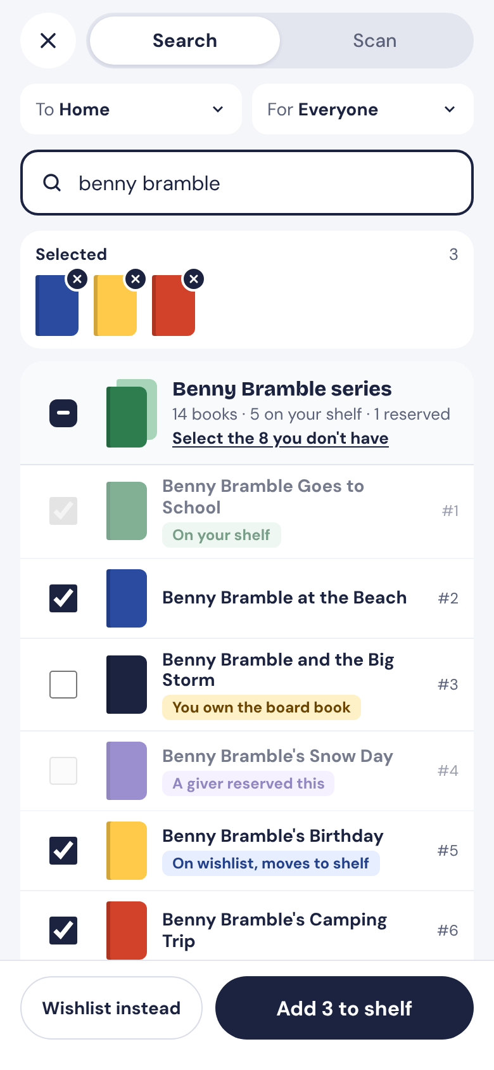
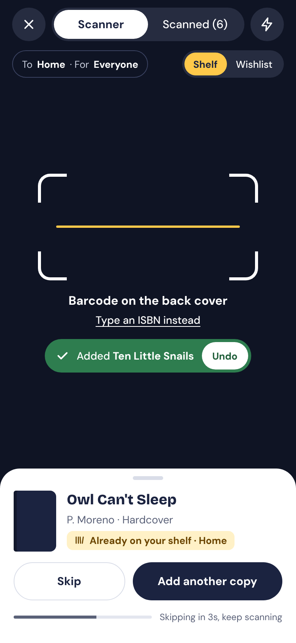
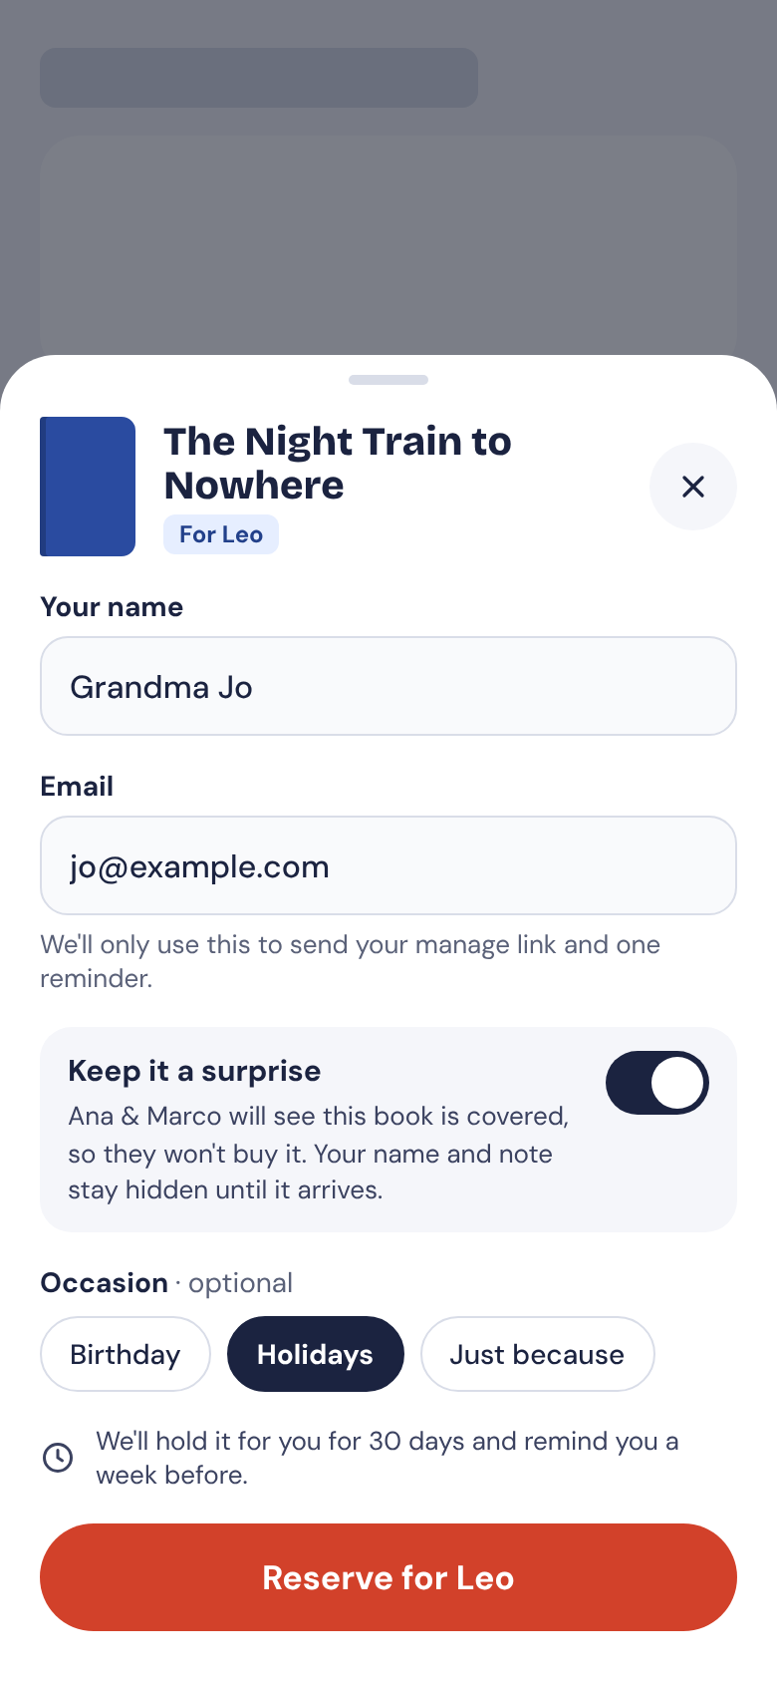
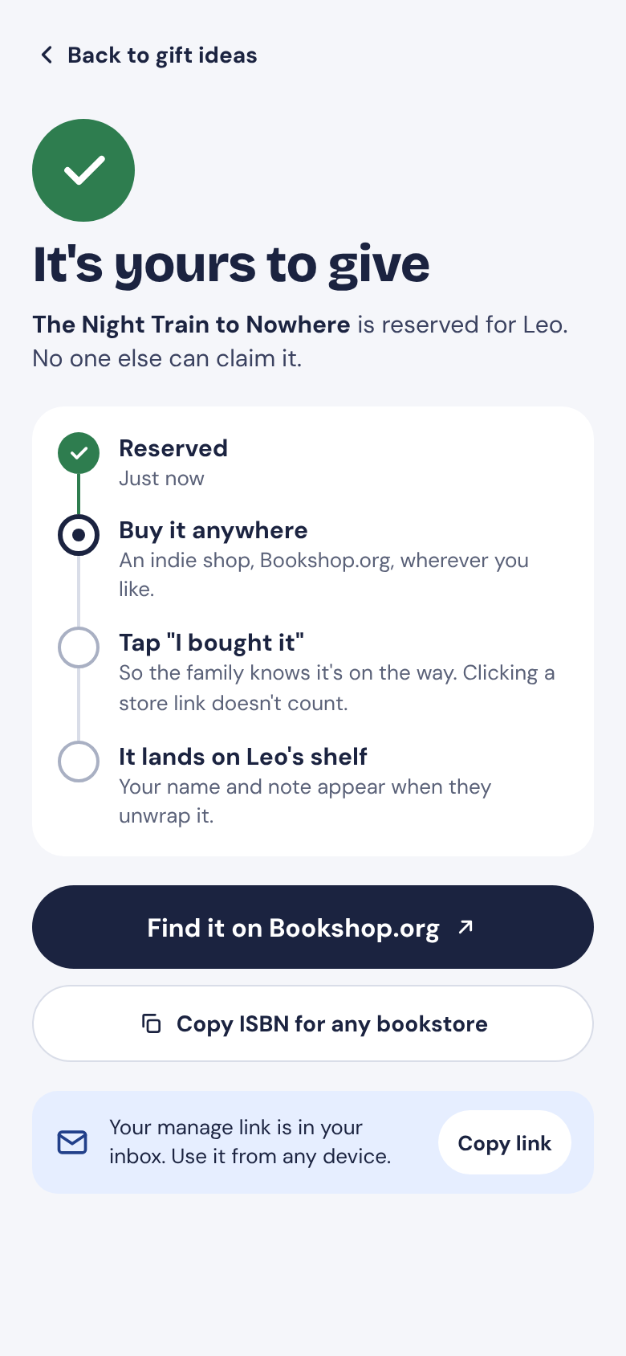
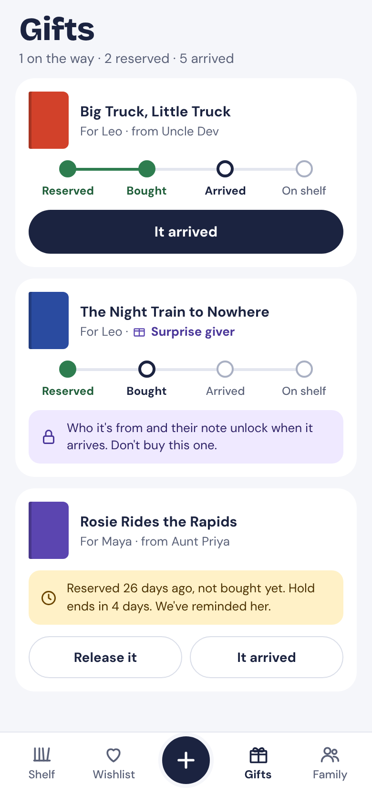
The PRD, grounded in shipped patterns
PATH B
Readers
Shelf
Series
Scan
Gift page
Reserve
Confirmed
Gift tracker
Path A drew the spec. Path B drew the experience.
The result: 8 screens built on patterns from apps people already use.
The best screen here is the one I forgot to write about in the PRD.
Notes:
Same loop, eight screens this time. Different look too, since it isn’t bound to the PRD’s placeholder theme. Path A drew the spec. Path B drew the experience. Every screen here started from a pattern in an app people already use. And the highlighted one, Confirmed, doesn’t exist anywhere in the PRD. Honestly, the best screen here is the one I forgot to write. I’ll come back to that. Let’s go side by side on three screens.

Slide 11
Same PRD. Different outcomes.
Where the two designs diverged
Decision | Path A: the baseline | Path B: research first
Screens drawn | 7, one per PRD section | 8, 7 + 1 the PRD never had
Gift page | Gift ideas first and duplicate check buried | “Already have it?” duplicate check comes first
Adding a series | “Select all” grabs owned books too | Only the ones they don’t have yet
After reserving | Nothing shown | A four-step “what happens next”
Surprise gifts | Title hidden, so someone could double-buy | Title shown; giver and note locked
Look and feel | The design system base theme, not kid friendly | A new look, chosen for the family audience
A design-minded PM curates inputs with context, real-world patterns, a design system, and feedback
One added input made the difference here and our first design pass much stronger and more defensible
Notes:
Before we zoom in, here’s the scoreboard. Same PRD, same tool, same afternoon, and the designs went different ways on almost every screen that matters. Path A drew seven screens, one per PRD section. Path B drew eight, including a screen the PRD never asked for. On the gift page, A put gift ideas first and buried the one check Grandma came for; B put the check first. On a series, A’s “select all” grabbed books they already own; B only selects what they don’t have. After reserving, A shows nothing; B walks the giver through what happens next. On surprise gifts, A hides the title, which means a parent can buy the same book; B shows the title and only locks the giver and the note. None of these are style choices. Every one is a product decision the PRD left open, and each one changes what a real person does. We’ll look at three of them up close in a minute.

Slide 12
The first AI draft uncovers the questions.
Your next step is to find answers.
Each open question will turn into a guess from either you, the engineer or the agent unless you go looking for answers.
Notes:
Here’s the limit of Path A. It’s great at finding questions. But a list of 21 questions on a Thursday afternoon, with no designer and a build starting Monday, mostly turns into 21 guesses. Path B asks a different question: somebody has already shipped a gift registry, a barcode scanner, a multi-select picker. How did they do it, and did it work?

Slide 13
Use case deep dive
KID’S SHELF
We trace one user story from a line in the PRD to the prototype
Use Case: Adding a whole book series to a shelf
Notes:
Let’s make this concrete. I’m going to take one user story, adding a whole book series to the shelf, and follow it all the way through: what the PRD says, what drawing it exposed, how research proposed an answer, and how you’d test it.

Slide 14
One user story, walked screen by screen
1
The PRD’s answer: “Select all in this series”
This approach leaves many gaps
THE USER STORY
“As a parent, I want to add every Benny Bramble book we have to our digital book shelf with as few taps as possible, so that our digital shelf matches our real shelf and we do not receive duplicate books.”
2
“As few taps as possible”: Select all checks all 14, so the parent has to accurately un-check every book they don’t own, one by one.
3
“Matches our real shelf”: miss one, and an unowned book is marked as owned. Givers see “already on their shelf” and skip it.
4
“No duplicate books”: baseline design also checks 5 books already on the shelf and 1 reserved gift.
The requirement is met. The user story isn’t.
Notes:
Let’s take one requirement and walk the user story through it, one clause at a time. Here’s the story: as a parent, I want to add every Benny Bramble book we have to our digital shelf with as few taps as possible, so the digital shelf matches our real one and we don’t receive duplicate books. The PRD’s answer is “select all in this series.” Books go into a review tray, and nothing is added until you tap Add. Sounds complete. Now walk it. “As few taps as possible”: there are 14 books in the series and the family owns some of them, so select all checks all 14 and the parent has to un-check every book they don’t own, one at a time. “Matches our real shelf”: if they miss one, a book they don’t own gets marked as owned, and the gift page tells Grandma it’s already on their shelf, so nobody ever buys it. “No duplicate books”: select all also checks the 5 books already on the digital shelf and one a relative has reserved as a gift. The PRD shows badges for those, but never says whether they can be selected at all. So the requirement is met, and the user story still fails on every clause. That gap was sitting inside a requirement I’d signed off on, and drawing it is what found it.

Slide 15
Design Comparison
PATH A
PATH B
A: “Select all” grabs all books, even one they own and one a relative reserved
B: “Select the 8 you don’t have.” CTA with owned and reserved books stay visible but locked. One tap add
Pattern: Shopify’s nested select, Cash App’s pinned picks, Shopee’s sticky Add button
Notes:
Path A did exactly what the PRD said: select all in the series. On a phone, that selected a book they already own and one a grandparent already reserved. That’s two duplicates from one tap. Shopify solved this for merchants picking product variants: a parent row that’s partly checked, with unavailable items visible but flagged. Path B borrows that, and the button now says what it really does: select the eight you don’t have.

Slide 16
How it got caught before a line of code
1 · INVESTIGATE
2 · RESEARCH
3 · VALIDATE IT
Draw it, then walk it as the parent
Ask who already
solved it
Put both in
front of parents
Path A drew the requirement exactly as written. Walking the story through it showed “select all” picking books they shouldn’t buy.
Shopify’s picker: select a group, skip what’s unavailable. Path B locked owned and reserved books, and the button became “Select the 8 you don’t have.”
Task: “Add every Benny Bramble book you own.” Watch whether anyone adds one they don’t own, or trusts the lock.
Gives: the decision
Found: the question
Found: a proposed answer
Cost to find it here, one afternoon.
Cost after launch, exponential
Notes:
So here’s how this one got caught, and it’s the whole method in miniature. Step one, investigate: draw the requirement exactly as written, then walk the user story through it as the parent. That’s what found the question. Step two, research: ask who already solved “pick a group but skip some.” Shopify did, for merchants picking product variants. Path B borrowed it: owned and reserved books stay visible but locked, and the button tells you the truth, select the eight you don’t have. That’s a proposed answer, not a decision. Step three is testing, and I want to be straight with you: I haven’t run it yet. That’s why the ledger still says hypothesis. The test is simple: give parents both versions and one task, add every Benny Bramble book you own, and watch whether anyone adds one they don’t own, re-adds one already on the shelf, or trusts the lock. Finding this cost me an afternoon. Finding it after launch costs duplicate books, unhappy parents, and a rework ticket.

Slide 17
A screen the PRD didn’t have
BONUS USE CASE
PATH B
What it’s for: right after Grandma reserves a book, it shows her what happens next, and that buying it is still on her. Reserving isn’t buying. Tapping “I bought it” is what tells the family the book was purchased.
Why the PRD missed it: the rule was written down that clicking a store link doesn’t count as buying. On paper, “Reserve” looked like the end of the flow, but there is more for the buyer to still do.
What found it: walking the flow as Grandma, tap by tap. After “Reserve” she’d think she was done, then buy it without telling anyone, or forget to buy it altogether.
Some requirements only show up when you walk the flow.
You can’t list what you haven’t drawn.
Pattern: Bolt Food’s order timeline, Blank Street’s gift link
Notes:
One more, as a bonus. This is a screen the PRD didn’t even have. Here’s what it’s for: the moment right after Grandma taps Reserve. It shows her the four steps: it’s reserved, buy it anywhere, tap “I bought it,” and it lands on Leo’s shelf. And it makes one thing very clear: step three is on her. Reserving isn’t buying. Why did the PRD miss it? The rule was right there in the doc, decision D-11: clicking a store link doesn’t count as a purchase, only the giver saying “I bought it” does. Good rule. But a rule in a document isn’t a moment on a screen. On paper, Reserve looked like the end of the flow, so nobody wrote the screen after it. It only showed up when I walked the flow as Grandma, tap by tap, and asked: what does she think happens now? She thinks she’s done. So she buys it at the store and never tells anyone, or she forgets, and the hold quietly expires. Every food delivery app solves this with a timeline right after you order, so you know what’s next and what’s on you. Path B borrowed that. In Path A, this would have shipped as a little toast that says “Reserved!” That’s the point of mocking things up and walking the flows: some requirements only show up when you do. You can’t list what you haven’t drawn.

Slide 18
The verdict
KID’S SHELF
Why research-first wins, what it saves you, and who should have the final say.
Notes:
So, two paths, same PRD. Let’s score it. Why Path B comes out ahead, what catching this early actually saves you, and then the part that matters most: who gets to decide which direction ships. Spoiler: it isn’t me.

Slide 19
Why Path B is much better
It answers, not just asks
It brings
receipts
It finds what you forgot
Instead of dumping open questions on you, it proposes answers borrowed from a successful product
“Shopify does it this way” ends a debate faster than “I think.” Stakeholders agree sooner.
A whole screen and 4 edge cases the PRD does not cover.
Path A is the floor everyone in this room should be hitting.
Path B is what a design-minded builder would do.
Notes:
Three reasons. One: it doesn’t just raise questions, it settles most of them. Two: every decision comes with a receipt. When a stakeholder pushes back, you’re not defending your taste, you’re pointing at an app millions of people already use. Three: it finds things you didn’t know to ask about, like the confirmation screen. Path A is the minimum. Path B is how you work like the designer you don’t have.

Slide 20
When you find it decides what it costs
One missing screen and 4 edge cases, found at three different moments in time
IN DESIGN
IN BUILD
AFTER LAUNCH
Resolved in minutes with Claude
1 week
Weeks + Churn
Built then rebuilt. About a half day per edge case, a few days for the missing screen.
CS ticket, backlog refinement, roadmapping, then the fix waits for the next release.
All the while Grandma already bought a duplicate book.
Design is the cheapest place to be wrong.
*Your timelines may vary but the business impact does not
Notes:
So what did finding a whole screen and four edge cases early actually save? I’ll give you my estimate, not a study, because the famous “a hundred times more expensive in production” number doesn’t trace back to a real source. In design, it cost an afternoon: change a frame, add a row to the ledger. In build, an engineer builds the literal version first, and then you rebuild it. Call it about a day per edge case for re-scoping, rebuilding and retesting, plus a few days for the missing confirmation screen, which needs design, copy, build and probably an email. That’s one to two weeks of engineering spent twice. After launch, it’s weeks. You’re cleaning up bad data, like books marked as owned that aren’t. You’re triaging support. The fix waits for the next release. And the cost isn’t only yours anymore: a grandparent already paid for a book the kid has, and the one promise Kid’s Shelf makes is broken. Your numbers will be different. The order won’t be.

Slide 21
The workflow to take home
PATH A DOES HAVE VALUE
PATH B
PATH B
CLOSE THE LOOP
CLOSE THE LOOP
2
3
4
5
1
Research before you redraw
Ask for distinct solutions
Prototype and test
Write it back and align
Draw it literally
Put the PRD on screens. Give it a low-fi wireframe treatment to get direction. List every question it exposes.
Materially different approaches, not style changes, with trade-offs and flagged questions.
Make it clickable. One task, about five users per round.
Decisions go into the PRD. Open questions become roadmap bets.
A reference brief: 3–5 shipped flows, what to borrow, why it might not fit.
Design decisions are product decisions. This is how you make them on purpose.
Notes:
Here’s the whole thing on one slide, and you can start tomorrow. One: draw the PRD literally and list every question it exposes. That’s Path A, and it’s the floor. Two: before you redraw, research. Write a reference brief, three to five shipped flows, including why each might not fit. Three: when you prompt, ask for different solutions, not different styling, and make the model flag what the PRD doesn’t answer. Two and three are Path B, and I’ll give you the prompts in a second. Four: make the strongest direction clickable and put it in front of about five people with one real task. Five, the step people skip: write the decisions back into the PRD, walk the business through the prototype, and turn whatever’s still open into explicit roadmap bets. If you have a designer, do this with them. If you’re solo, this is the job.

Slide 22
Prompts to steal
USE THIS ON EVERY DESIGN PROMPT
“Using this PRD and its constraints, propose 2-4 materially different interaction approaches. Explain each one’s trade-offs and assumptions. Flag unanswered questions instead of silently turning them into requirements.”
RESEARCH · MOBBIN
RESEARCH · FREE
REFINE · SCREEN BY SCREEN
“Search Mobbin for how shipped apps handle [a given screen type]. Pull 1-3 examples. For each: define the problem it solves, what to borrow, why it might not fit [product]. Then build [screen] and cite the app behind each decision.”
“Here are [N] screenshots of [flow] from [apps]. For each: the problem it solves, what to borrow, why it might not fit us. Then propose two materially different versions of [screen], with trade-offs.”
“Walk this flow as [persona] trying to [task]. On each screen, list where they’d hesitate, what they’d misunderstand, and what they’d reach for that isn’t there. Flag any fix that changes a requirement.”
Notes:
Four prompts, one slide. The top one goes on every design prompt you write. Ask for materially different approaches, not four color schemes. Make it explain trade-offs. And the last sentence does the heavy lifting: flag unanswered questions instead of quietly turning them into requirements. That turns the model into a requirements auditor, and it’s a bit of productive friction at the exact moment the researchers say the risk is highest, your first prompt. Underneath are the three I use in the workflow. The Mobbin one is what I ran for Path B, through my skill. The free one works with screenshots from the App Store, Google Play or Banani. And the screen-by-screen one is for after the first build: walk the flow as a real person and list where they’d stall. If a fix changes a requirement, it has to say so.

Slide 23
Evals: make good output repeatable
The model doesn’t learn from your feedback on its own. Your context does.
A rubric every screen must pass
Close the loop
Every PRD requirement for the screen is visible
Empty, loading and error states exist
Each pattern names its source app, or says it’s a guess
Only design-system tokens, no one-off colors
Open questions are flagged, not quietly decided
Accessibility checks: tap targets 44px or larger; text passes contrast
Run the rubric as a grader prompt after every generation
Log each failure as a row in the ledger
Turn repeat failures into rules in your skill, project instructions or design system
Keep a golden set of 3–5 screens you love to compare against
Notes:
How do you get consistent quality instead of a lucky draw? Evals. For design, an eval doesn’t need to be fancy. It’s a rubric every generated screen has to pass: every requirement visible, empty and error states present, each pattern names where it came from, only your design system’s tokens, open questions flagged instead of decided, and basic accessibility. You can run that rubric yourself or have a second model grade against it. Here’s the honest part: the model doesn’t learn from your thumbs-up or your corrections on its own. What learns is your context. When the same failure shows up twice, write it down as a rule in your skill, your project instructions or your design system, so the next run starts smarter. And keep a small golden set, three to five screens you love, so “good” is something you can point at. That’s how this gets better every time you use it.

Slide 24
The Design Partner skill
TAKE TONIGHT HOME
1 · Install it once
2 · Seven modes. Just ask
In the Claude app
PASS · “Find the gaps in this PRD.”
Download design-partner.zip from the GitHub release
Customize → + Add → Upload a skill
BUILD · “Design the invite flow from this brief.”
REFERENCE · “Borrow the layout from these screenshots.”
or in Claude Code
CRITIQUE · “Critique these screens as a first-time buyer.”
EVIDENCE · “What do these two customer calls settle?”
cp -r design-partner ~/.claude/skills/
QA · “Write the end-to-end test program.”
HANDOFF · “Draft the tickets, or the designer brief.”
Full runs end with a coverage report, the ledger and one next step. Small questions get small answers.
github.com/buddytrip05/design-partner
Free and MIT-licensed. No Claude? The prompt pack inside works in any AI tool.
Keep a DESIGN_RULES.md so it learns your product.
Notes:
Everything you saw tonight is packaged as a free skill on GitHub. Install it once: in the Claude app, download the zip from the release and upload it as a skill; in Claude Code, it’s one copy command. Then you don’t call it by name, you just ask, and it picks one of seven modes. Pass finds the gaps in a PRD, like we did tonight. Build makes a real design from a brief, with every state. Reference reads screenshots you like and tells you what to borrow and what not to. Critique walks your screens as a real person. Evidence plans and digests customer calls and usability tests, and it’s honest about how strong the signal is. QA writes the end-to-end test program. And Handoff drafts the specs and tickets for engineering, or the brief for your designer. Every full run ends the same way: a coverage report, the ledger, and one next step. Ask a small question, you get a small answer. Two tips: the prompt pack inside works in any AI tool, and keep a DESIGN_RULES.md file in your project. That file is how it gets smarter about your product over time.

Slide 25
You have designs. Now what?
1
2
3
4
Walk it screen by screen
Make it clickable
Test with users
Align and roadmap
Turn the best direction into a prototype people can tap through, not a deck of screenshots.
One real task, about five people per group. Watch where they stall.
Walk the business through it. Decided rows go in the PRD; open rows become roadmap bets.
Run the flow as each persona. Fix states, copy and edge cases one screen at a time.
A prototype people can tap through ends more debates than any words in a doc.
Notes:
So you walk out of here with two directions. What do you do Monday? Here’s what I actually do. First, I go screen by screen through the flow after the initial build, as each person who uses it, and work the usability: empty states, errors, copy, the edge cases the ledger flagged. Second, I make the strongest direction clickable. A prototype people can tap through, built in Claude Design or Lovable, says more than any set of screenshots. Third, I put it in front of real users with one real task, like the test we just talked about. And fourth, I walk the business through the same prototype. That’s where alignment actually happens. The rows we decided go back into the PRD. The rows still open become explicit bets on the roadmap, with the evidence we have so far. The prototype becomes the meeting.

Slide 26
The design patterns are a frame.
Your taste gives it personality.
ONE CAUTION
If every builder designs with the same AI, everything starts to look the same. Shipped patterns give you structure that works. Your design system is what makes it yours.
Introducing productive friction creates deliberate pauses that make you challenge the default.
Notes:
A fair worry: if we’re all designing with the same model and researching the same apps, does everything end up looking like everything else? Here’s how I think about it. Borrow the structure, because the structure is what’s been proven. Keep the look, the voice and the details as your own. Path A and Path B wear different visual systems on purpose. The patterns underneath could wear either one. The homogenization paper calls this productive friction: small, deliberate pauses that make you push back on the default. A reference brief, a design system and a user test are all friction of exactly that kind.

Slide 27
AI made the first draft cheap. Your team's advantage is in everything you do after the first draft.
Own it or partner with design on it. Either way, make intentional and defensible decisions—because if you don't, something else will.
Notes:
Here’s where I’ve landed. AI made the first draft cheap and fast. The advantage now isn’t generating. It’s everything after the first draft: the references you bring, the different solutions you ask for, the questions your designs expose, and the evidence you collect before you commit engineering time. Design decisions are product decisions. If you don’t have a designer, own them. If you do, be the partner who shows up with the edge cases and the why. Either way, don’t let them get made by default. Then open it up: what does your team do between the first AI draft and what you ship? Happy to walk through either canvas live.

Slide 28
Thank you
BPM DALLAS · COTALITY · NOV 10, 2026
Draw your PRD.
Then go find the answers.
PROTOTYPE
GITHUB
LINKEDIN
Play the missions
Get the skill
Let’s connect
path-b-demo.vercel.app
github.com/buddytrip05/design-partner
linkedin.com/in/buddy-triplett
Notes:
That’s it from me. Thank you to BPM Dallas for having me, and to Cotality for hosting us tonight. If you take one thing home: go draw your PRD, and then go find the answers before anyone else guesses them. Before you go, three codes. The first is the Path B prototype, live, with five missions you can play as a parent or a gift-giver. The second is the Design Partner skill on GitHub: the whole workflow from tonight, packaged so you can run it on your own PRDs. The third is my LinkedIn. Come find me after, or connect there. I’m happy to share the deck, the Kid’s Shelf PRD, or walk through either canvas live.

Slide 29
A reference brief, not a mood board
PATH B
8 Mobbin searches before the first frame. For each reference: the problem it solves, what to borrow, and why it might not fit.
Reference | Problem it solves | Worth borrowing | Why it might not fit us
Crate & Barrel registry | Showing guests what’s left to buy | “6 total · 1 purchased · 5 remaining” strip | Registries track quantities; we track single titles
Shopify product picker | Picking many while skipping some | Partly checked parent row, flagged items | Merchants pick variants; parents pick stories
Goodreads scanner | Adding a stack of books fast | Result card under a live camera | It adds to one reader; we add to a family
Bolt Food and Instacart trackers | Showing what happens after you order | A step tracker on every order | Food arrives in minutes; gifts take weeks
Notes:
Path B adds one step before drawing. I ran eight searches in Mobbin, a library of real screens from shipped apps, using my mobbin-design skill. Not for a mood board. For decisions. How does a registry show what’s already been bought? How does a scanner keep the camera open between scans? How do you select a group but skip what’s already taken? The point is that the model starts from patterns that already shipped, not from its statistical average. Here’s the habit that makes it work, and you can do it in any tool. For each reference, write three things: what problem it solves, which interaction is worth borrowing, and why it might not fit your context. That last column is what turns a mood board into a brief. My Path B canvas notes covered the first three columns. The fourth is the one I’d add next time, because it’s where you catch yourself copying something that doesn’t transfer. A registry counts quantities. We only care about single titles. Good to know before you borrow its layout.

Slide 30
Sources
RESEARCH AND DATA
PATTERNS, METHODS AND TONIGHT’S TOOLS
Romero et al. “Usable but Conventional.” arXiv:2605.15124, May 2026. 92 participants, blind evaluation.
Shin et al. “Interrogating Design Homogenization in Web Vibe Coding.” arXiv:2603.13036, 2026. Conceptual: 63 sources, 6 tools.
UX Tools. “State of Prototyping: Spring 2026.” 1,478 respondents, March–April 2026.
Lenny’s Newsletter & Noam Segal. “AI tools are overdelivering.” Dec 2025. 1,750 respondents.
diginomica. “Figma crosses $1 billion revenue.” Feb 19, 2026. Figma Make non-designer share.
Lenny’s Newsletter. “Why Reddit built its own AI prototyping.” Oct 26, 2026.
Figma. “2026 AI Report.” June 2026. 8,403 responses over three years plus 639 interviews, 10 countries. The 90% figure is among people building AI-powered products.
Coverage of the Figma report: mpost.io (Jul 8, 2026), Blog du Modérateur (Jun 25, 2026).
Nielsen, J. “Why You Only Need to Test with 5 Users.” NN/g, 2000.
Pattern libraries: Mobbin, Banani References, VP0. Checked Oct 2026.
App patterns on the slides (Shopify, Crate & Barrel, Bolt Food, Instacart, Cash App, Shopee, Blank Street, Goodreads) were viewed in Mobbin, Oct 2026.
“When you find it decides what it costs”: the speaker’s own estimates for a small team, not a study.
Path A and Path B designs: Kid’s Shelf MVP PRD v1, built in Claude Design, Oct 2026. Books and families are sample data.
Path B prototype: path-b-demo.vercel.app
Design Partner skill: github.com/buddytrip05/design-partner
Claude Help Center. “Use Skills in Claude.” Install steps.
Notes:
Leave this up during Q&A, or share the deck link afterward. Everything with a number on it is linked here, and the one slide that’s my own estimate, the cost slide, is labeled as that.

